Slide 1

COMPUTER memory
short term and long term
speed, capacity, compression
formats, access

Slide 2
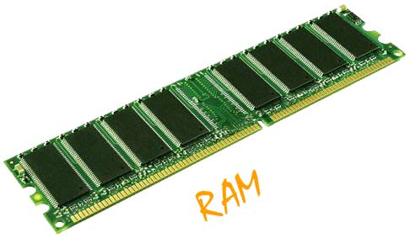
Short-term Memory - RAM
Random access memory (RAM)
on silicon chips
100 nano-second access time
usually volatile (lose information if power turned off)
data transferred at around 100 Mbytes/sec
Some non-volatile RAM used to store basic set-up information
Typical desktop computers: 64 to 256 Mbytes RAM,
4 GB, 8GB,16 GB

Slide 3
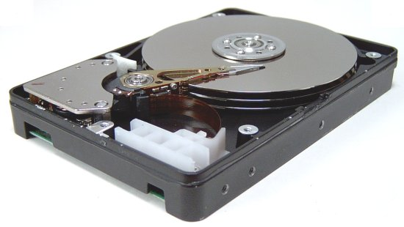
Long-term Memory - disks
magnetic disks
floppy disks store around 1.4 Mbytes
hard disks typically 40 Gbytes to 100s of Gbytes ( Now a days 1 TB ) access time ~10ms, transfer rate 100kbytes/s
optical disks
use lasers to read and sometimes write
more robust that magnetic media
CD-ROM - same technology as home audio, ~ 600 Gbytes
DVD - for AV applications, or very large files

Slide 4
Speed and capacity
what do the numbers mean?
some sizes (all uncompressed) …
this book, text only ~ 320,000 words, 2Mb
the Bible ~ 4.5 Mbytes
scanned page ~ 128 Mbytes
(11x8 inches, 1200 dpi, 8bit greyscale)
digital photo ~ 10 Mbytes
(2–4 mega pixels, 24 bit colour)
video ~ 10 Mbytes per second
(512x512, 12 bit colour, 25 frames per sec)

Slide 5
Compression
reduce amount of storage required
lossless
recover exact text or image – e.g. GIF, ZIP
look for commonalities:
text: AAAAAAAAAABBBBBCCCCCCCC 10A5B8C
video: compare successive frames and store change
lossy
recover something like original – e.g. JPEG, MP3
exploit perception
JPEG: lose rapid changes and some colour
MP3: reduce accuracy of drowned out notes

Slide 6
Storage formats - text
ASCII - 7-bit binary code for each letter and character
UTF-8 - 8-bit encoding of 16 bit character set
RTF (rich text format) - text plus formatting and layout information
SGML (standardized generalised markup language) - documents regarded as structured objects
XML (extended markup language) - simpler version of SGML for web applications

Slide 7
Storage formats - media
Images:
many storage formats : (PostScript, GIFF, JPEG, TIFF, PICT, etc.)
plus different compression techniques (to reduce their storage requirements)
Audio/Video
again lots of formats : (QuickTime, MPEG, WAV, etc.)
compression even more important
also ‘streaming’ formats for network delivery

Slide 8
processing and networks
Moore’s law
limits of interaction
networked computing

Slide 9
Moore’s law
computers get faster and faster!
1965 …
Gordon Moore, co-founder of Intel, noticed a pattern
processor speed doubles every 18 months
PC … 1987: 1.5 Mhz, 2002: 1.5 GHz
similar pattern for memory
but doubles every 12 months!!
hard disk … 1991: 20Mbyte : 2002: 30 Gbyte
baby born today
record all sound and vision
by 70 all life’s memories stored in a grain of dust!

Slide 10
The myth of the infinitely fast machine
implicit assumption … no delays an infinitely fast machine
what is good design for real machines?
good example … the telephone :
type keys too fast
hear tones as numbers sent down the line
actually an accident of implementation
emulate in design

Slide 11
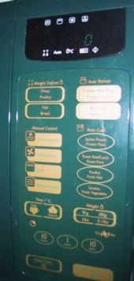
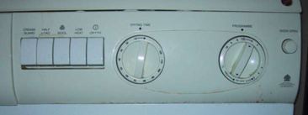
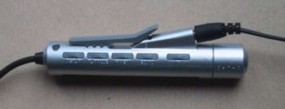
In design Focus: physical controls what is good design for real machines?
specialist controls needed …
industrial controls, consumer products, etc.
easy-clean
smooth buttons
multi-function control
large buttons
clear dials
tiny buttons

Slide 12
Networked computing
Networks allow access to …
large memory and processing
other people (groupware, email)
shared resources – esp. the web
Issues
network delays – slow feedback
conflicts - many people update data
unpredictability

Slide 13
The Interaction includes
Interaction models
Translations between user and system
Norman / Abowd and Beale
Interaction styles
The nature of user/system dialog
Context
Social, organizational, motivational
Ergonomics
physical characteristics of interaction

Slide 14
Models of interaction
Donald Norman’s Interaction Model (execution/evaluation cycle)
Abowd and Beale’s Model

Slide 15
Some terms of interaction
domain – the area of work under study
e.g. graphic design
goal – what you want to achieve
e.g. create a solid red triangle
task – how you go about doing it – ultimately in terms of operations or actions
e.g. … select fill tool, click over triangle
Note …
traditional interaction …
use of terms differs a lot especially task/goal !!!

Slide 16
Donald Norman’s model
Concentrates users view on the interface
Seven stages
user establishes the goal
formulates intention
specifies actions at interface
executes action
perceives system state
interprets system state
evaluates system state with respect to goal
Norman’s model concentrates on user’s view of the interface

Slide 17
execution/evaluation loop
user establishes the goal
formulates intention
specifies actions at interface
executes action
perceives system state
interprets system state
evaluates system state with respect to goal
goal
execution
evaluation
system

Slide 18
Norman model with example

Slide 19
execution/evaluation loop
goal
user establishes the goal
user formulates intention
specifies actions at interface
executes action
perceives system state
interprets system state
evaluates system state with respect to goal
execution
evaluation
system

Slide 20
execution/evaluation loop
user establishes the goal
formulates intention
specifies actions at interface
executes action
perceives system state
interprets system state
evaluates system state with respect to goal
goal
execution
evaluation
system

Slide 21
execution/evaluation loop
user establishes the goal
formulates intention
specifies actions at interface
executes action
perceives system state
interprets system state
evaluates system state with respect to goal
goal
execution
evaluation
system

Slide 22
execution/evaluation loop
user establishes the goal
formulates intention
specifies actions at interface
executes action
perceives system state
interprets system state
evaluates system state with respect to goal
goal
execution
evaluation
system

Slide 23
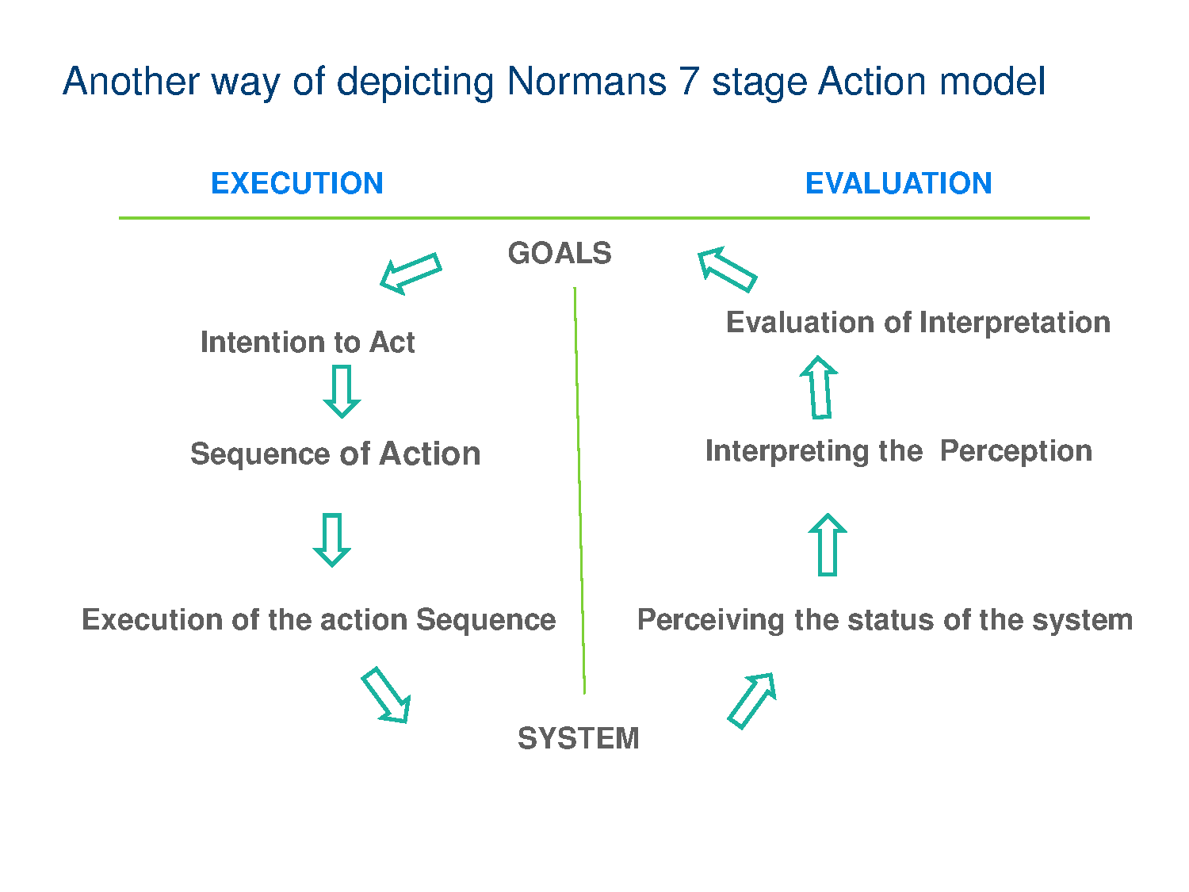

Slide 24
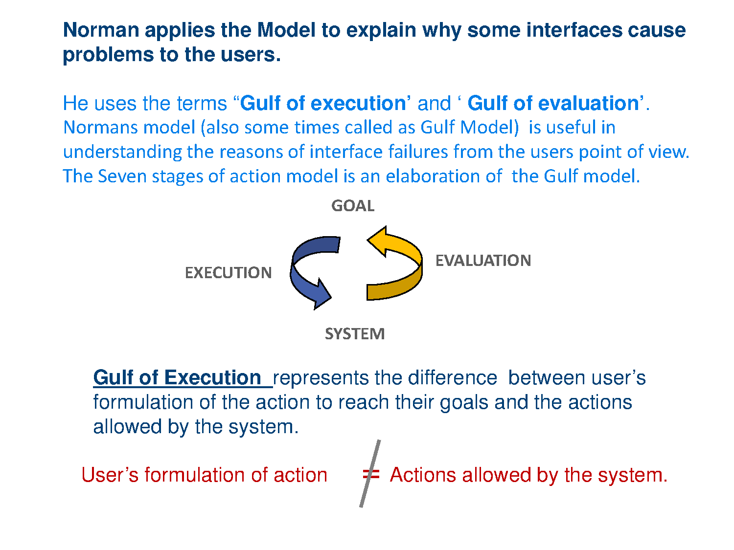
(Application of ‘7’ stages mode)l

Slide 25
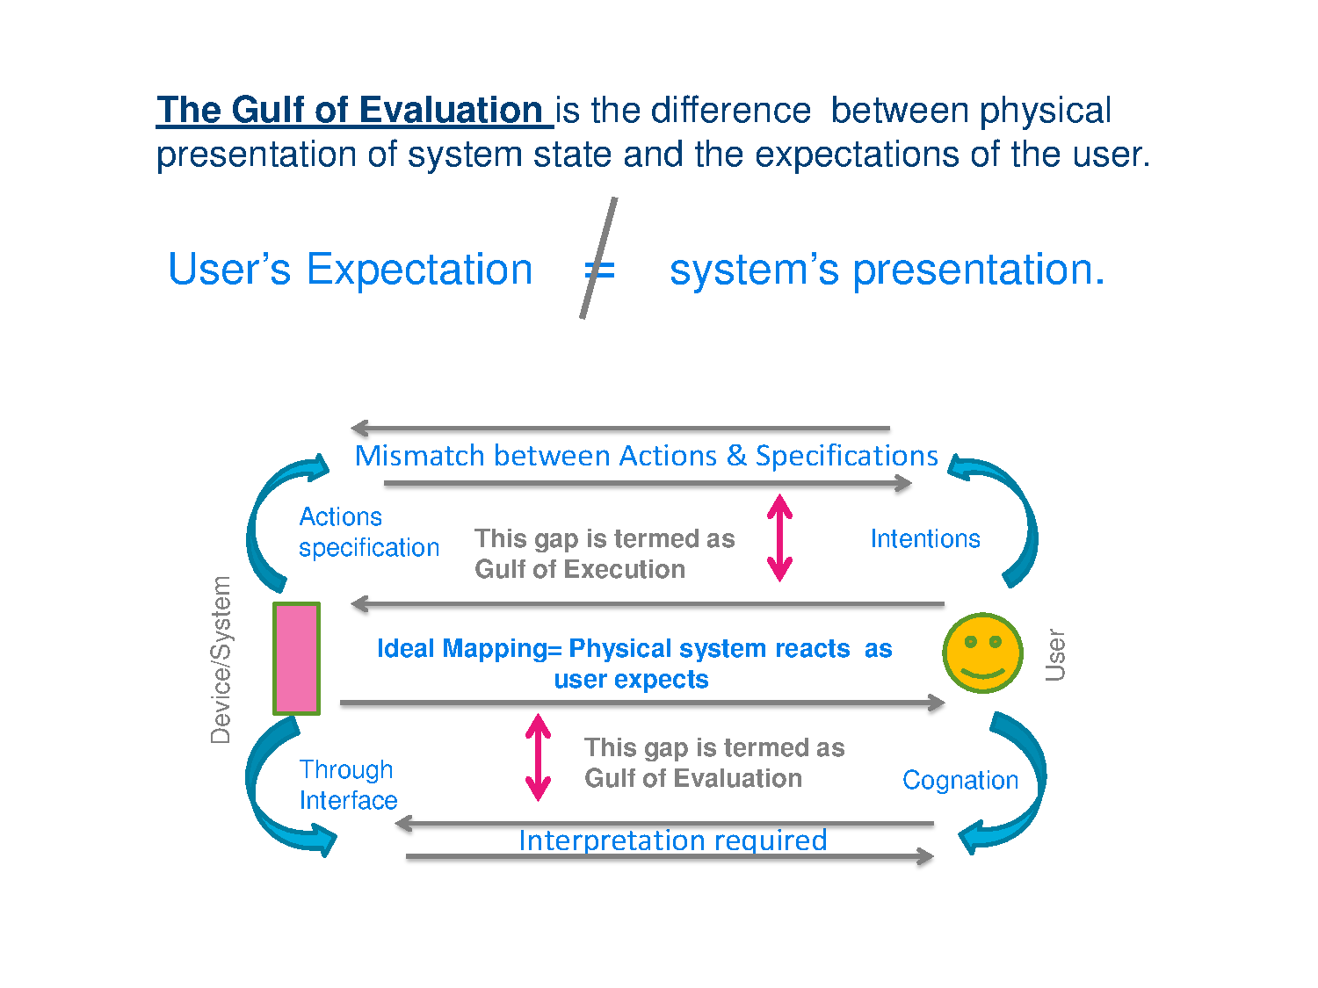

Slide 26

Human error – Errors using an interface
slip
understand system and goal
correct formulation of action
incorrect action
mistake
may not even have right goal!
Fixing things?
slip – better interface design
mistake – better understanding of system

Slide 27
Abowd and Beale framework
extension of Norman…
their interaction framework has 4 parts
user
input
system
output
each has its own unique language interaction ⇒ translation between languages
problems in interaction = problems in translation
O
output
presentation
observation
S
core
U
task
performance
I
input
articulation

Slide 28
Using Abowd & Beale’s model
user intentions → translated into actions at the interface → translated into alterations of system state → reflected in the output display → interpreted by the user
general framework for understanding interaction
not restricted to electronic computer systems
identifies all major components involved in interaction
allows comparative assessment of systems
an abstraction

